Slide 1
INTRO TO HTML
MCNDHS
Ms. Wang

Slide 2
AIM: HOW ARE WEBPAGES CONSTRUCTED BY HTML?
Do Now:
See attachment.
daily Grade:
On time: 25%
No cellphone: 25%
Notes: 25%
Classwork/Homework: 25%

Slide 3
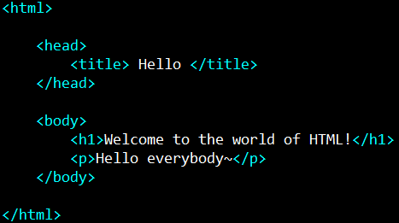
HTML VOCABULARY
When you write in HTML, the “alphabet” are called ELEMENTS/TAGS
example:

Slide 4
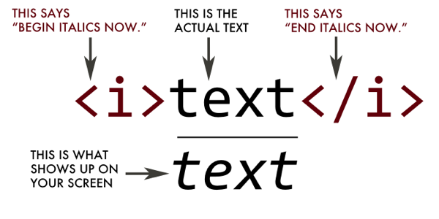
WHAT DO ELEMENTS/TAGS DO?
Think of tags as a RULE. You place the text in between the tags to “code”

Slide 5
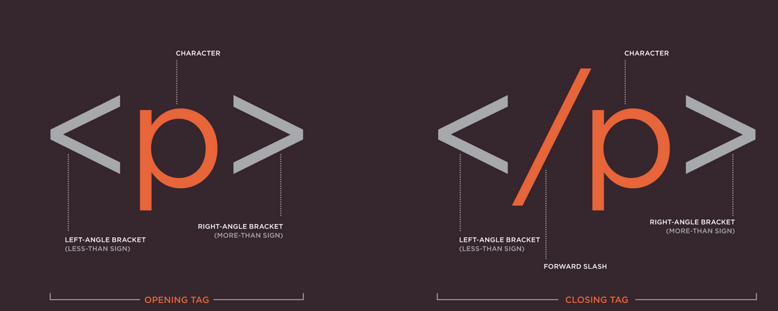
THE ANATOMY OF TAGS
Opening tag
Closing tag

Slide 6


HOW DO BROWSERS TRANSLATE YOUR CODE?
Code→rendering engine→display
html
css
javascript
is read by C++ commands
C++ orders computer hardware to display your creation!
html
css
javascript

Slide 7
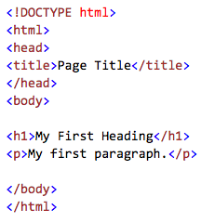
EVERY WEBPAGE IS STRUCTURED LIKE THIS:
webpage
what appears on the top of the browser
everything inside <html> means what you are coding is in html.
the physical content that will appear on your website.

Slide 8
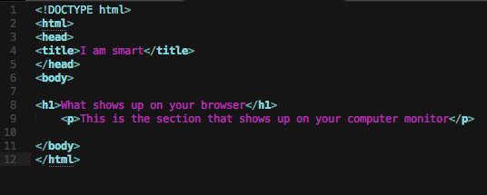
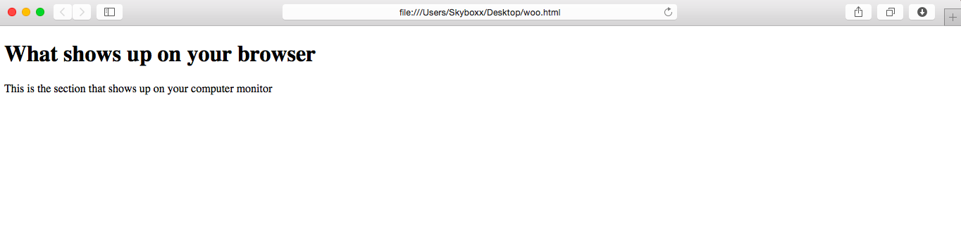

Slide 9
ACTIVITY
Please locate and list all the opening and closing tags you see!

